Slide 1
ICT-PreAward-eCAT-
Pre_Award_Conformance_and_ Test_Strategy-1.0.1
Version: 1.0.1
Status: In use
Editors: Giancarlo De Stefano, Consip

Slide 2
Statements
Statement of originality
This deliverable contains original unpublished work except where clearly indicated otherwise. Acknowledgement of previously published material and of the work of others has been made through appropriate citation, quotation or both.
Statement of copyright
This deliverable is released under the terms of the Creative Commons Licence accessed through the following link: http://creativecommons.org/licenses/by/3.0/.
In short, it is free to
Share — to copy, distribute and transmit the work
Remix — to adapt the work
Under the following conditions
Attribution — You must attribute the work in the manner specified by the author or licensor
(but not in any way that suggests that they endorse you or your use of the work).
Page <number>

Slide 3
Revision History
Version | Date | Editor | Org | Description
1.0.0 | 01.05.2011 | Hugo Oliveira | ANCP | First release
1.0.1 | 30.06.2012 | Giancarlo De Stefano | Consip | Update for alignement with PEPPOL EIA Release 4 and Transfer of Ownership
Page <number>

Slide 4
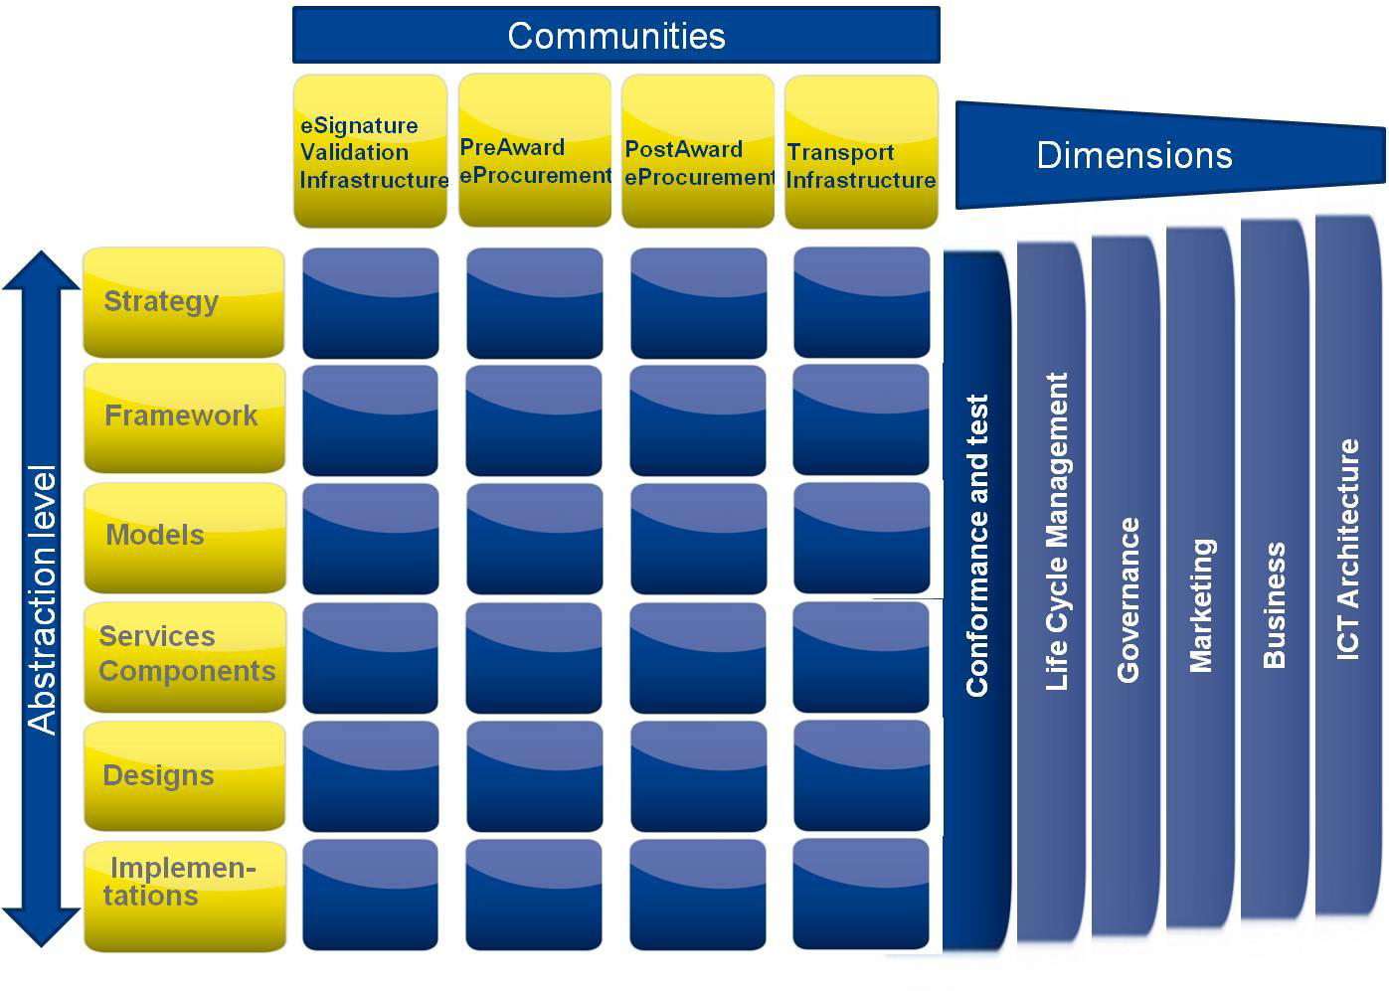
PEPPOL Conformance and Testing
Page <number>

Slide 5

Conformance and testing Strategy
  The vision of PEPPOL is that any company, including SMEs, in the European Union can communicate electronically with any EU governmental institution in all procurement processes.
    Facilitate EU-wide interoperable public eProcurement network
    Work with existing national solutions
  Electronic documents that are conformant to PEPPOL specifications (PEPPOL BIS) can be exchanged widely within Europe in open procurement communities and the issuer can with high degree of certainty expect the document to pass validation by the receiver.
  Goal of PEPPOL interoperability is to electronically enable parties to exchange a set of information to be used within a minimal but well defined set of procurement processes without previous bi lateral setup of data, content rules and process specifications.
Page <number>

Slide 6
Conformance and testing Strategy
  PEPPOL compliance means that a solution or implementation of PEPPOL process is conformant to a suite of specifications that gives interoperability on legal, organisational, semantic and technical layers, that defines a PEPPOL solution.
  Participants in PEPPOL Core Community must claim that their implementations are conformant to PEPPOL specifications.
  PEPPOL conformance is claimed through a testing process at design time done by the implementers.
  PEPPOL conformance claim is based on self evaluation.
  Testing provides the processes and tools for participant to claim conformance
  PEPPOL requires that specific test processes is being conducted, with positive compliance criteria fulfilled and documented.
Page <number>

Slide 7
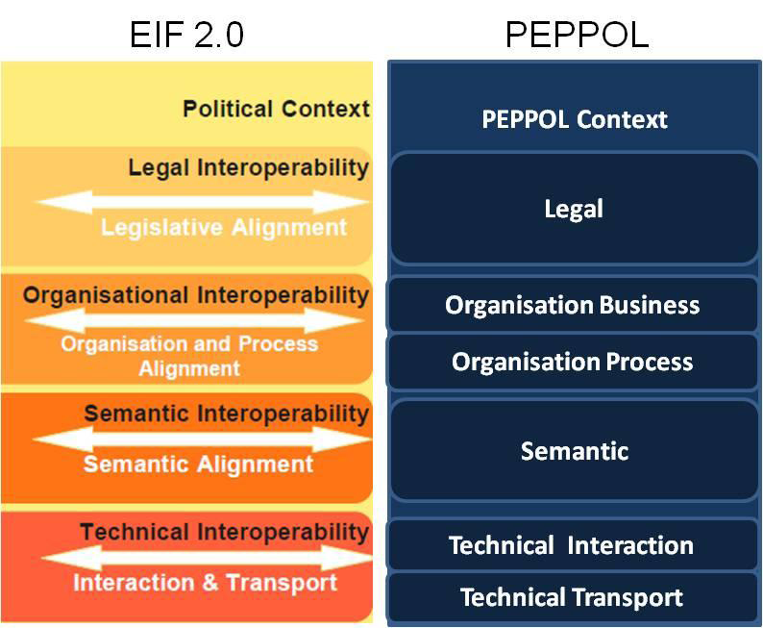
Conformance and testing scope
  Quality assurance at design time to ensure that implementations of PEPPOL Specifications (PEPPOL BIS) is actually compliant with the specifications.
  Covers Conformance to the Post Award Processes.
  Covers interoperability between Access Points (See Transport Infrastructure)
  Covers following interoperability layers
    Legal
    Organisation
    Business
    Organisation
    Process
    Semantic
    Technical Interaction
Page <number>

Slide 8
Conformance and testing scope
  Activities that are NOT in scope of This Interoperability Conformance and Testing:
    Internal conformance and testing of individual implementations and interfaces
    Conformance and testing to eSignature(Technical Interaction layer, see eSignatureInfrastructure Conformance and Testing)
    Conformance and testing of the Technical Transport layer (see Transport Infrastructure Conformance and Testing)
    Run time conformance testing i.e. validation of received production eProcurementdocument instances (see ICT Architecture dimension).
Page <number>

Slide 9
Conformance and testing principles
  PEPPOL Conformance and testing for pre-award was based on the test methodology, created for post-award in cooperation with the CEN ISSS WS/BII (See Framework)
  PEPPOL Post Award eProcurement Conformance and Testing for pre-award will have to use and be continually aligned with and the results from CEN ISSS WS/GITB
Page <number>

Slide 10

eProcurement
without borders in Europe
www.peppol.eu
Page <number>

